Slide 1

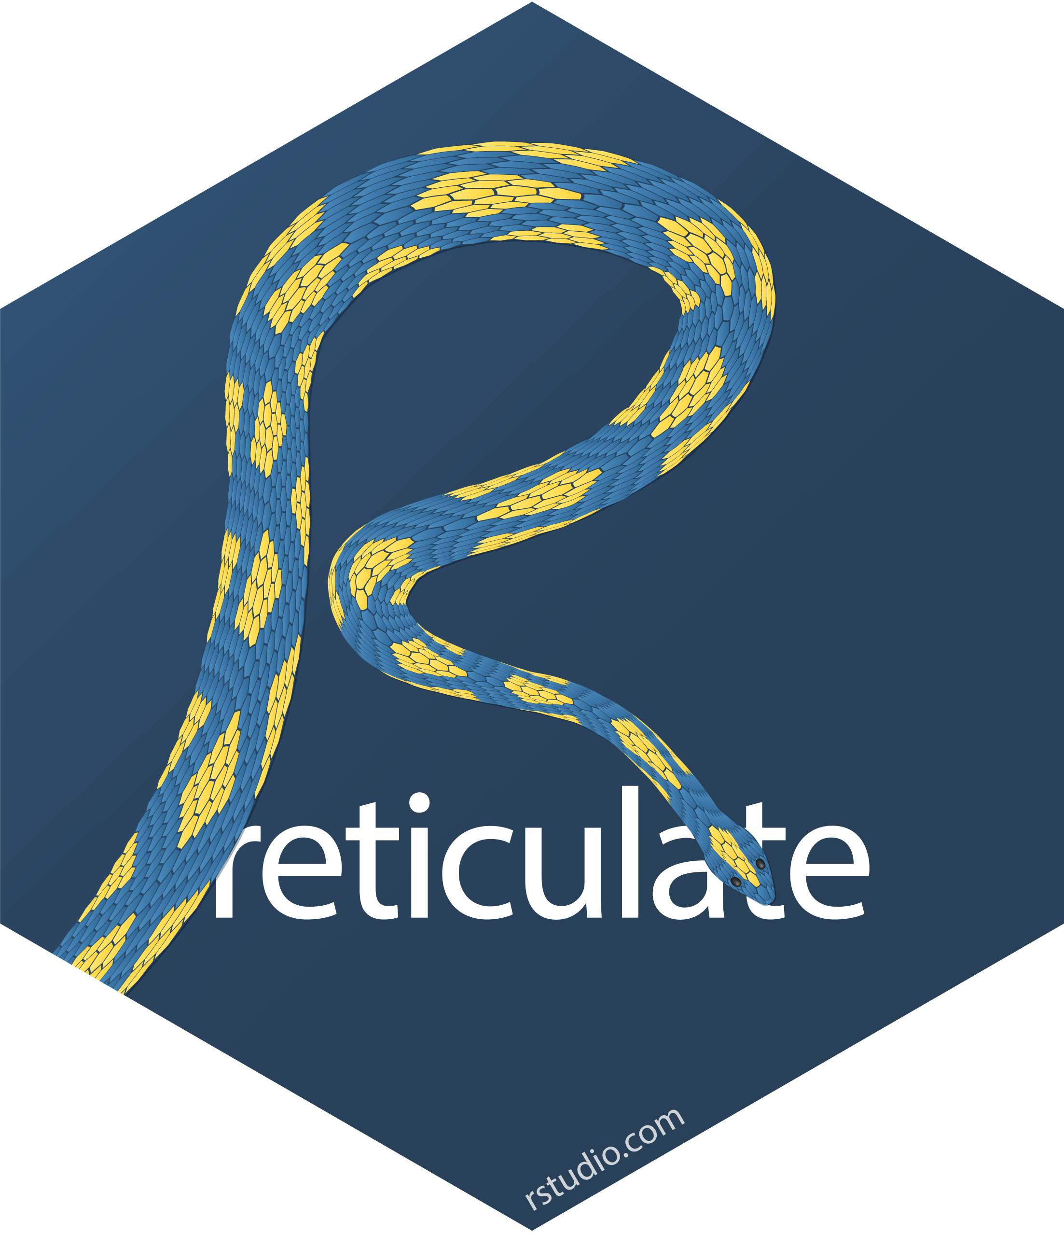
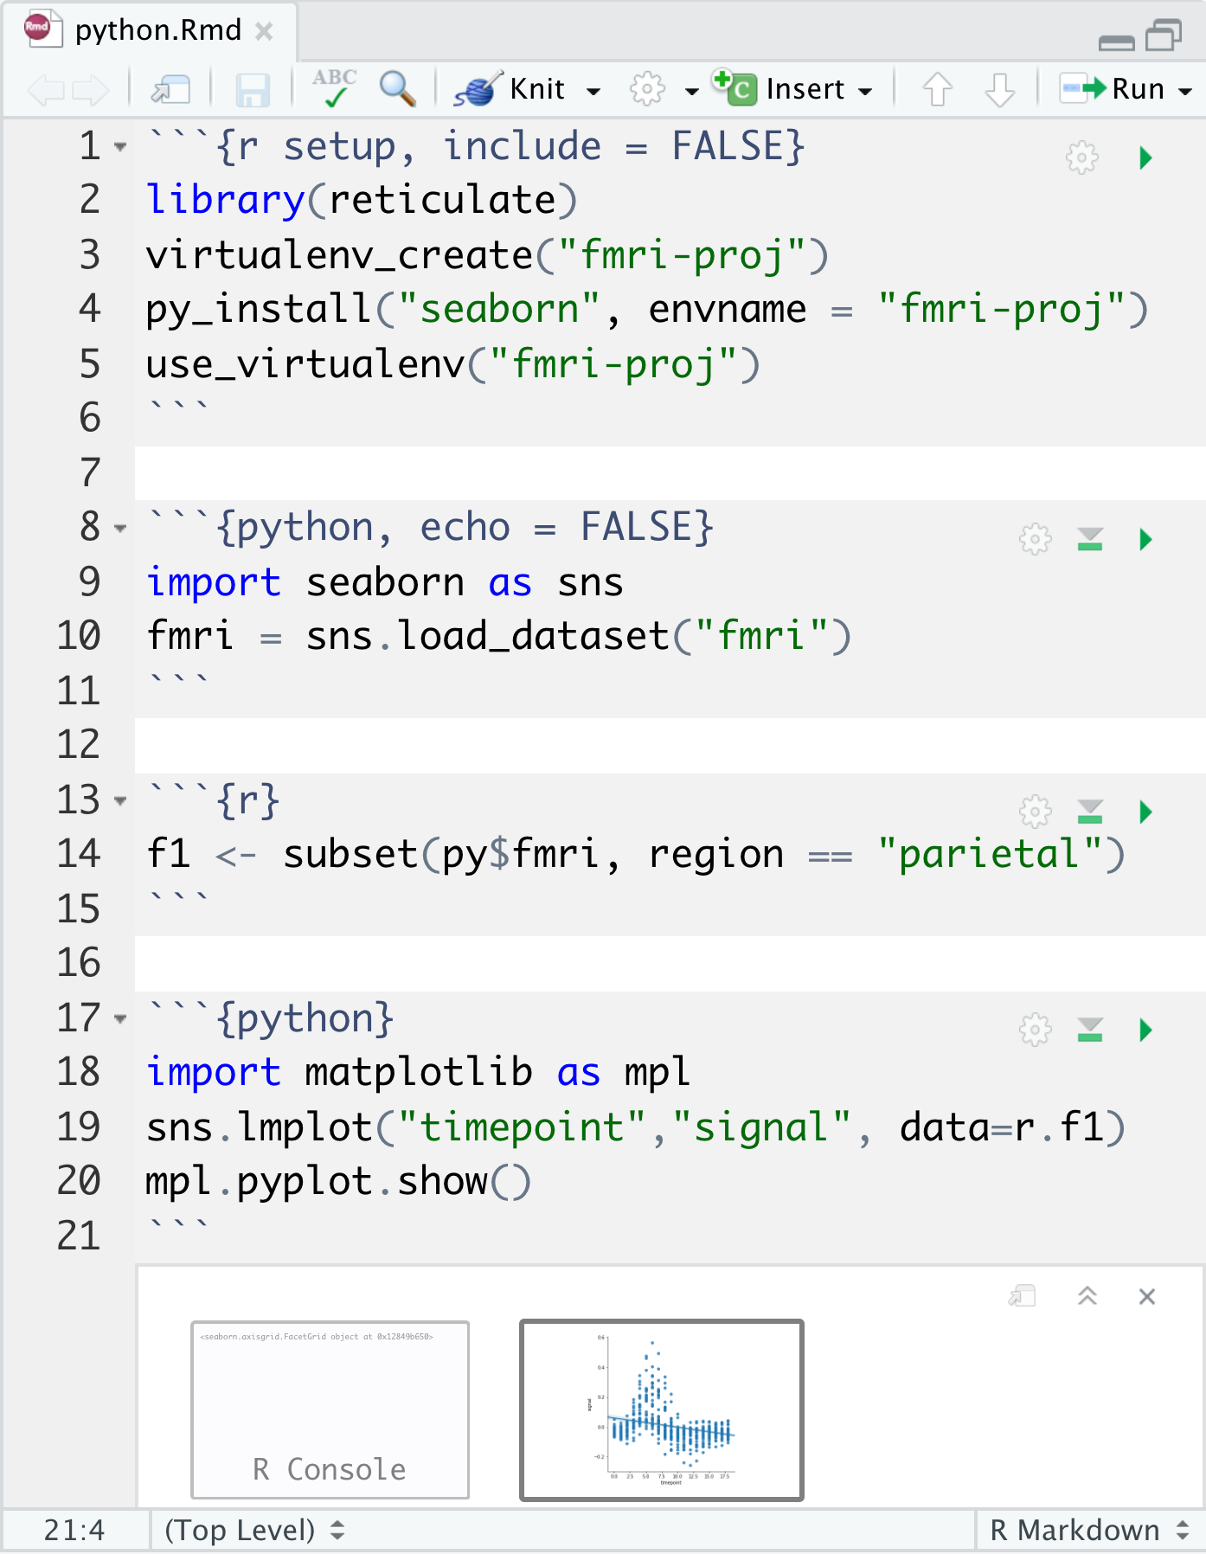
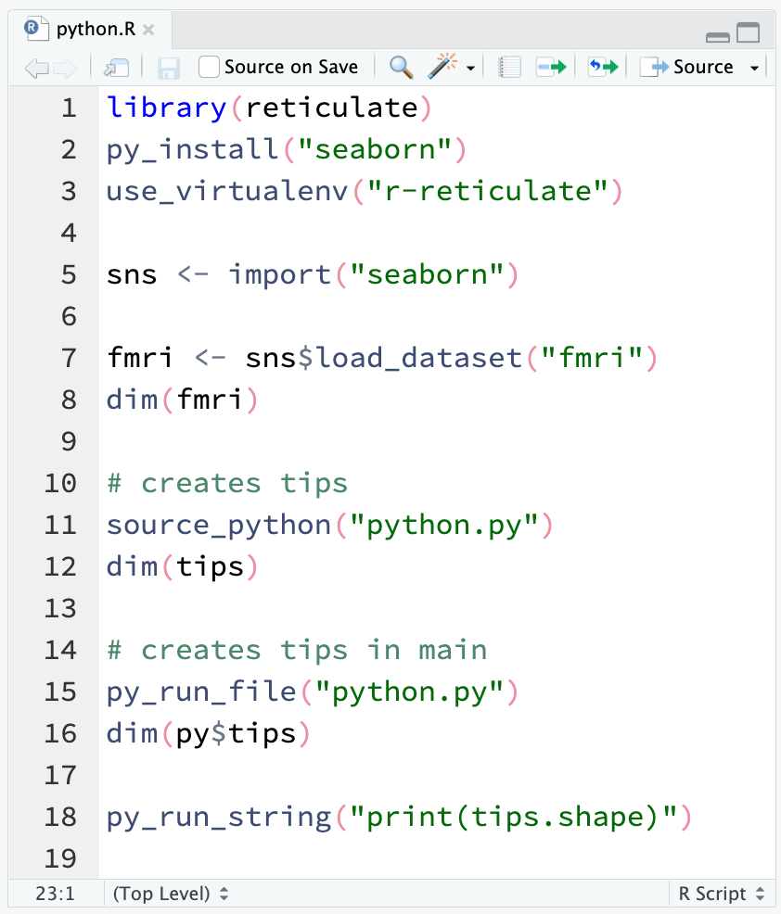

Use Python with R with reticulate : : CHEATSHEET
The reticulate package lets you use Python and R together seamlessly in R code, in R Markdown documents, and in the RStudio IDE.
Python in R Markdown
Python in R
(Optional) Build Python env to use.
knitr versions >= 1.18 will automatically use the reticulate engine for Python chunks. See ?reticulate::eng_python for a listing of supported knitr chunk options.
Suggest the Python environment
to use, in your setup chunk.
Begin Python chunks with ```{python}. Chunk options like echo, include, etc. all work as expected.
Use the py object to access objects created in Python chunks from R chunks.
Python chunks all execute within a
single Python session so you have access to all objects created in previous chunks.
Use the r object to access objects created in R chunks from Python chunks.
Output displays below chunk,
including matplotlib plots.
Call Python from R code in three ways:
IMPORT PYTHON MODULES
Use import() to import any Python module. Access the attributes of a module with $.
import(module, as = NULL, convert = TRUE, delay_load = FALSE) Import a Python module. If convert = TRUE, Python objects are converted to
their equivalent R types. Also import_from_path(). import("pandas")
import_main(convert = TRUE)
Import the main module, where Python executes code by default. import_main()
import_builtins(convert = TRUE) Import Python's built-in functions. import_builtins()
SOURCE PYTHON FILES
Use source_python() to source a Python script and make the Python functions and objects it creates available in the calling R environment.
source_python(file, envir = parent.frame(), convert = TRUE) Run a Python script, assigning objects to a specified R environment. source_python("file.py")
Object Conversion
Tip: To index Python objects begin at 0, use integers, e.g. 0L
Helpers
Reticulate provides automatic built-in conversion between Python and R for many Python types.
dict(..., convert = FALSE) Create a Python dictionary object. Also py_dict() to make a dictionary that uses Python objects as keys. dict(foo = "bar", index = 42L)
np_array(data, dtype = NULL, order = "C") Create NumPy arrays. np_array(c(1:8), dtype = "float16")
array_reshape(x, dim, order = c("C", "F")) Reshape a Python array. x <- 1:4; array_reshape(x, c(2, 2))
py_func(f) Wrap an R function in a Python function with the same signature. py_func(xor)
py_main_thread_func(f) Create a function that will always be called on the main thread.
iterate(it, f = base::identity, simplify = TRUE) Apply an R function to each value of a Python iterator or return the values as an R vector, draining the iterator as you go. Also iter_next() and as_iterator().
py_iterator(fn, completed = NULL) Create a Python iterator from an R function. seq_gen <- function(x){ n <- x; function() {n <<- n + 1; n}}; py_iterator(seq_gen(9))
py_capture_output(expr, type = c("stdout", "stderr")) Capture and return Python output. Also py_suppress_warnings().
py_get_attr(x, name, silent = FALSE) Get an attribute of a Python object. Also py_set_attr(), py_has_attr(), and py_list_attributes().
py_help(object) Open the documentation page for a Python object. py_help(sns)
py_last_error() Get the last Python error encountered. Also py_clear_last_error() to clear the last error. py_last_error()
py_save_object(object, filename, pickle = "pickle", ...) Save and load Python objects with pickle. Also py_load_object(). py_save_object(x, "x.pickle")
with(data, expr, as = NULL, ...) Evaluate an expression within a Python context manager. py <- import_builtins(); with(py$open("output.txt", "w") %as% file, { file$write("Hello, there!")})
RUN PYTHON CODE
R | Python
Single-element vector | Scalar
Multi-element vector | List
List of multiple types | Tuple
Named list | Dict
Matrix/Array | NumPy ndarray
Data Frame | Pandas DataFrame
Function | Python function
NULL, TRUE, FALSE | None, True, False
Execute Python code into the main Python module with py_run_file() or py_run_string().
py_run_string(code, local = FALSE, convert = TRUE) Run Python code (passed as a string) in the main
module. py_run_string("x = 10"); py$x
py_run_file(file, local = FALSE, convert = TRUE) Run Python file in the main module. py_run_file("script.py")
py_eval(code, convert = TRUE) Run
a Python expression, return the result.
py_eval("1 + 1")
Access the results, and anything else in Python's main module, with py.
py An R object that contains
the Python main module and
the results stored there. py$x
Or, if you like, you can convert manually with
py_to_r(x) Convert a Python object to an R object. Also r_to_py().
tuple(..., convert = FALSE) Create a Python tuple. tuple("a", "b", "c")
CC BY SA Posit Software, PBC • info@posit.co • posit.co • Learn more at rstudio.github.io/reticulate • HTML cheatsheets at pos.it/cheatsheets • reticulate 1.37 • Updated: 2024-06

Slide 2
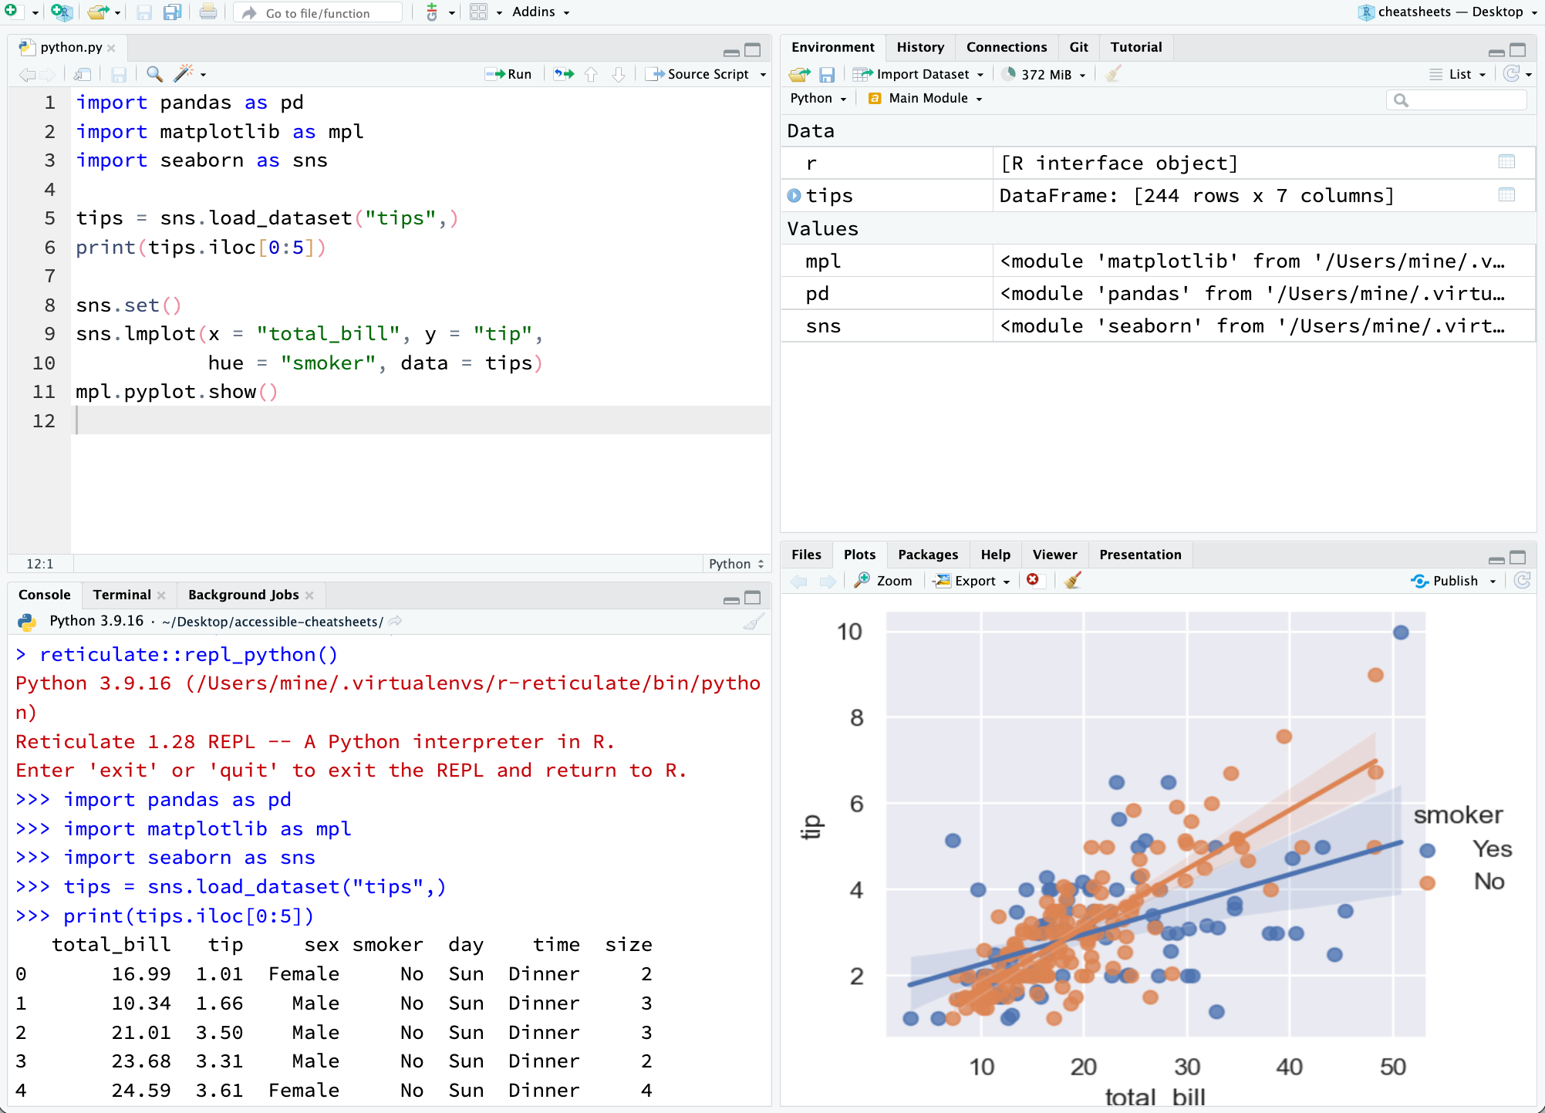

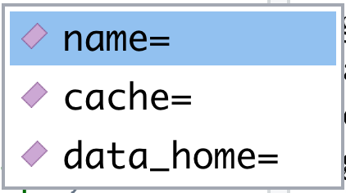
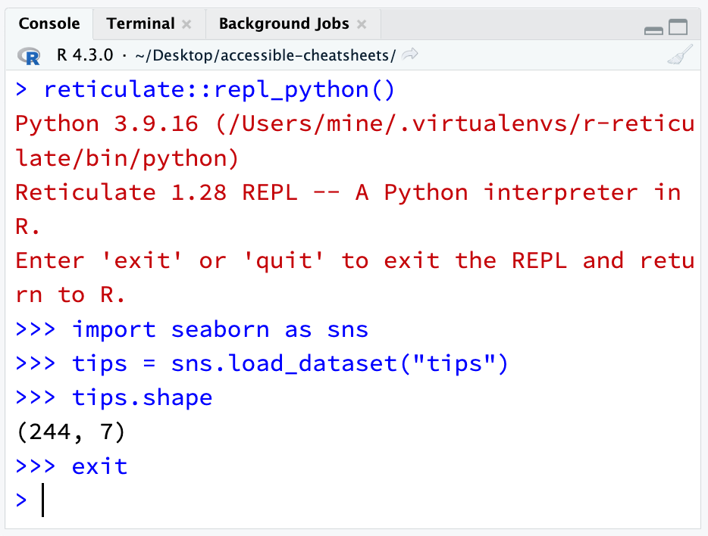
Python in the IDE
Requires reticulate plus RStudio v1.2+. Some features require v1.4+.
Configure Python
Syntax highlighting for Python scripts and chunks.
Tab completion for Python functions and objects (and Python modules imported in R scripts).
Source Python scripts.
Execute Python code line by line with Cmd + Enter (Ctrl + Enter).
View Python objects in the Environment Pane.
View Python objects in the Data Viewer.
Reticulate binds to a local instance of Python when you first call import() directly or implicitly from an R session. To control the process, find or build your desired Python instance. Then suggest your instance to reticulate. Restart R to unbind.
Find Python
Suggest an env to use
install_python(version, list = FALSE, force = FALSE) Download and install Python. install_python("3.9.16")
py_available(initialize = FALSE) Check if Python is available on your system. Also py_module_available() and py_numpy_module(). py_available()
py_discover_config() Return the detected installation of Python. Use py_config() to check which version has been loaded. py_config()
virtualenv_list() List all available virtual environments. Also virtualenv_root(). virtualenv_list()
conda_list(conda = "auto") List all available conda environments. Also conda_binary() and conda_version(). conda_list()
Set a default Python interpreter in the RStudio IDE Global or Project Options.
Go to Tools > Global Options... > Python for Global Options.
Within a project, go to Tools > Project Options... >Python.
Otherwise, reticulate scans the instances on your computer in the following order:
The instance referenced by the environment variable RETICULATE_PYTHON (if specified). Tip: set in .Renviron file.
Sys.setenv(RETICULATE_PYTHON = PATH) Set default Python binary. Persists across sessions! Undo with Sys.unsetenv(). Sys.setenv(RETICULATE_PYTHON = "/usr/local/bin/python")
The instances referenced by use_ functions if called before import().
use_python(python) Path to a Python binary. use_python("/usr/local/bin/python")
use_virtualenv(virtualenv) Path to or name of a Python virtualenv. use_virtualenv("~/myenv") use_virtualenv("r-keras")
A virtual env found in the current working directory: "./.venv"
Environments that are named after the imported module. e.g. ~/.virtualenvs/r-scipy/ for import("scipy")
The package default virtualenv, "r-reticulate".
At the location of the Python binary discovered on the system PATH (i.e. Sys.which("python"))
Create a Python env
virtualenv_create(envname = NULL, ...) Create a new virtual environment. virtualenv_create("r-pandas")
conda_create(envname = NULL, ...) Create a new conda environment. conda_create("r-pandas", packages = "pandas")
A Python REPL opens in the console when you run Python code with a keyboard shortcut. Type exit to close.
matplotlib plots display in plots pane.
Press F1 over a Python symbol to display the help topic for that symbol.
Python REPL
Install Packages
A REPL (Read, Eval, Print Loop) is a command line where you can run Python code and view the results.
Open in the console with repl_python(), or by running code in a Python script with Cmd + Enter (Ctrl + Enter).
repl_python(module = NULL, quiet = getOption("reticulate.repl.quiet", default = FALSE), input = NULL) Launch a Python REPL. Run exit to close. repl_python()
Type commands at >>> prompt.
Press Enter to run code.
Type exit to close and return to R console.
Install Python packages with R (below) or the shell:
pip install SciPy
conda install SciPy
py_install(packages, envname, ...) Installs Python packages into a Python env. py_install("pandas")
virtualenv_install(envname, packages, ...) Install a package within a virtualenv. Also virtualenv_remove(). virtualenv_install("r-pandas", packages = "pandas")
conda_install(envname, packages, ...) Install a package within a conda env. Also conda_remove(). conda_install("r-pandas", packages = "plotly")
CC BY SA Posit Software, PBC • info@posit.co • posit.co • Learn more at rstudio.github.io/reticulate • HTML cheatsheets at pos.it/cheatsheets • reticulate 1.28 • Updated: 2023-07

